Slide 1
Regularizing Deep Networks with Semantic Data Augmentation Yulin Wang, Gao Huang Department of Automation, BNRist, Tsinghua University, Yitong Xia, School of Automation Science and Electrical Engineering, BeiHang University 2021, IEEE

Slide 2
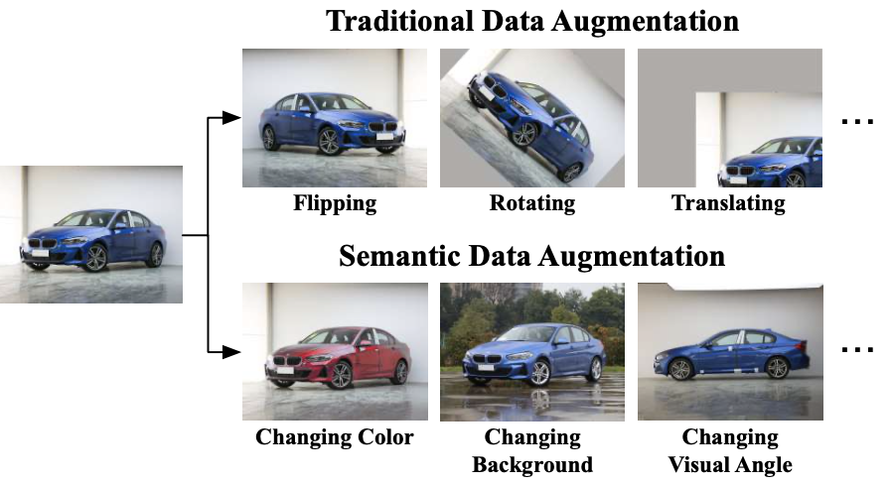
Overview
Main Idea: Implicit semantic data augmentation(ISDA).
Traditional: Cropping, Horizontal, Rotation, etc.
Semantic: Changing background(GAN), etc.

Slide 3
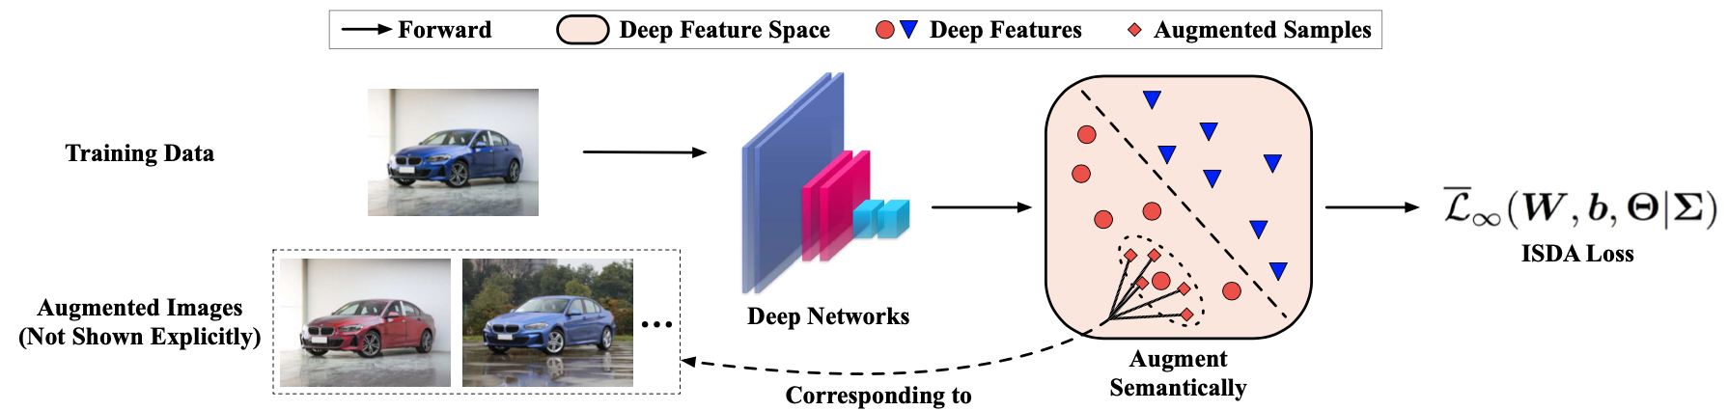
Overview
Advantages: Not require extra samples & highly efficient & Robust .
Basic: There exist many semantic directions in the deep feature space.
Method: Minimize a closed-form upper-bound of the expected CE loss.

Slide 4
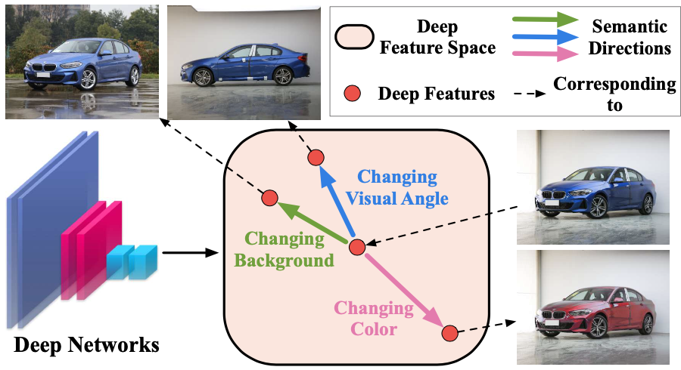
ISDA
Perform an online estimate of the covariance matrix of the features of each class.
Sample directions from a zero-mean multi-variate normal distribution.
A closed-form upper bound of the robust expected CE loss.

Slide 5
Semantic Direction Sampling
Human Annotation: Not feasible, inefficient, data limited.
Random Sampling: Yield many meaningless semantic directions.
ISDA: Sample random vectors from a zero-mean normal distribution.

Slide 6
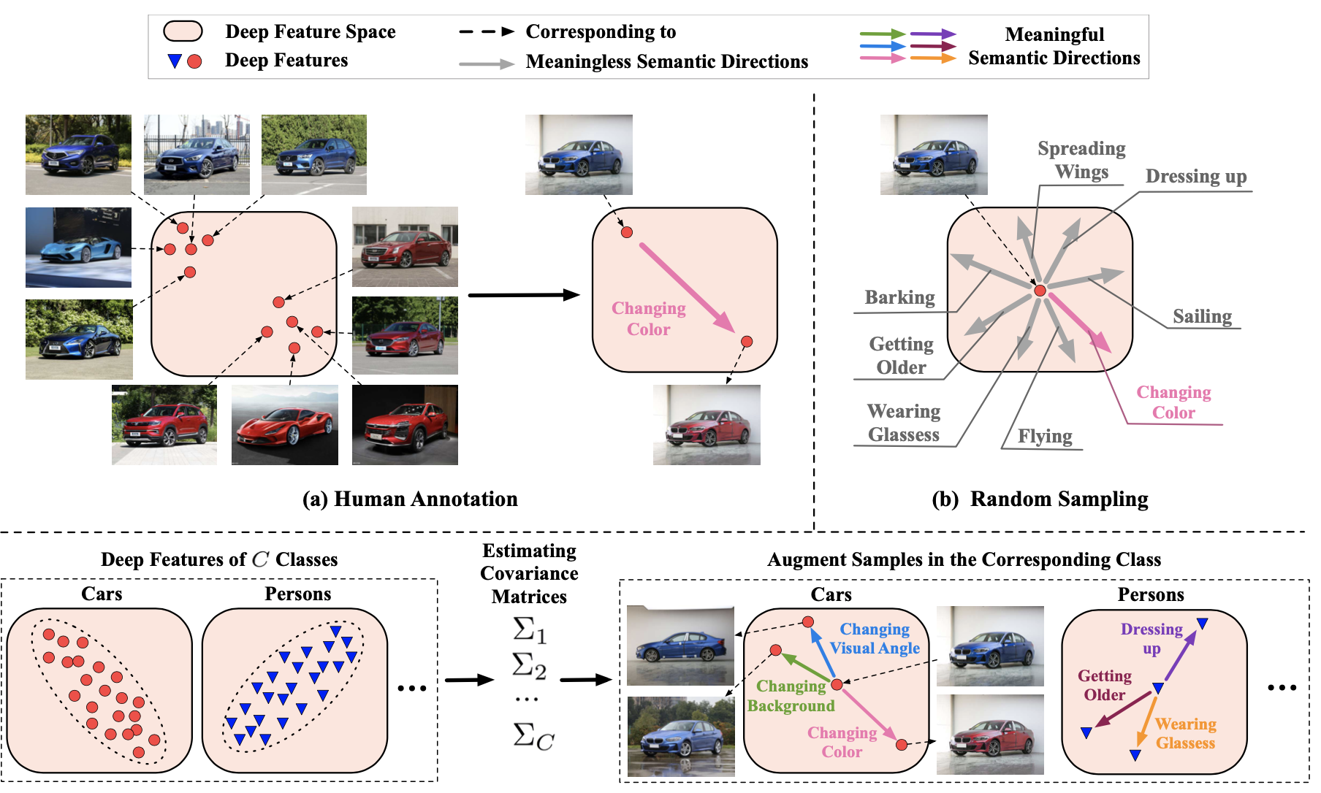

Slide 7
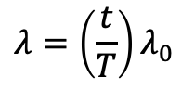
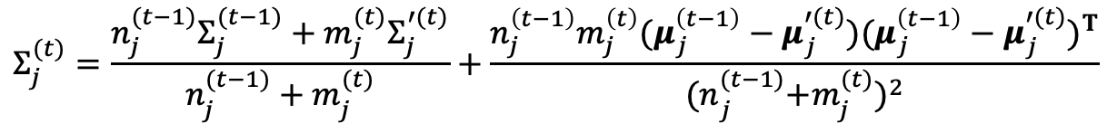
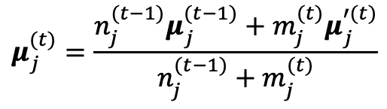
Algorithm
A deep network G with weights $Θ$ on a training set $Ζ=\left\{\left(x_{i},y_{i}\right)\right\},y_{i}ε\{1,…,C\}$ is the label of the $i^{th}$ sample. Let the A-dimensional vector $a_{i}{=[a_{i1},…,a_{iA}]}^{T}=\text{G}\text{(}x_{i}\text{,}Θ)\text{.}$
A normal distribution $Ν\left(0,Σ_{y_{i}}\right)$, $Σ_{y_{i}}$ is computed as:
$$μ_{j}^{(t)}=\frac{n_{j}^{(t−1)}μ_{j}^{(t−1)}+m_{j}^{(t)}μ_{j}^{′(t)}}{n_{j}^{(t−1)}+m_{j}^{(t)}}$$
$$Σ_{j}^{(t)}=\frac{n_{j}^{(t−1)}Σ_{j}^{(t−1)}+m_{j}^{(t)}Σ_{j}^{′(t)}}{n_{j}^{(t−1)}+m_{j}^{(t)}}+\frac{n_{j}^{\left(t−1\right)}m_{j}^{\left(t\right)}(μ_{j}^{\left(t−1\right)}−μ_{j}^{′(t)}){(μ_{j}^{\left(t−1\right)}−μ_{j}^{′(t)})}^{T}}{{{(n}_{j}^{(t−1)}+m_{j}^{(t)})}^{2}}$$
During training $C$ covariance matrices are computed and maintained. The augmented features ${\tilde{a}}_{i}$ is sampled from $Ν\left(0,{λΣ}_{y_{i}}\right)$, ${\tilde{a}}_{i}$ ~ $Ν\left(a_{i},{λΣ}_{y_{i}}\right)$ and $λ$ controls the strength of ISDA.
$$λ=\left(\frac{t}{T}\right)λ_{0}$$

Slide 8
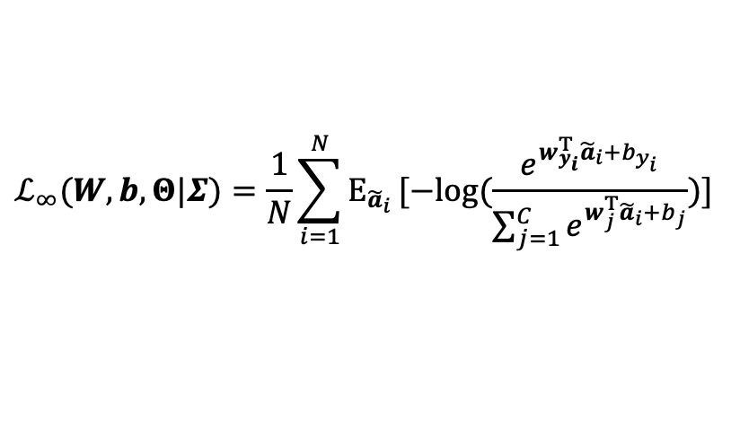
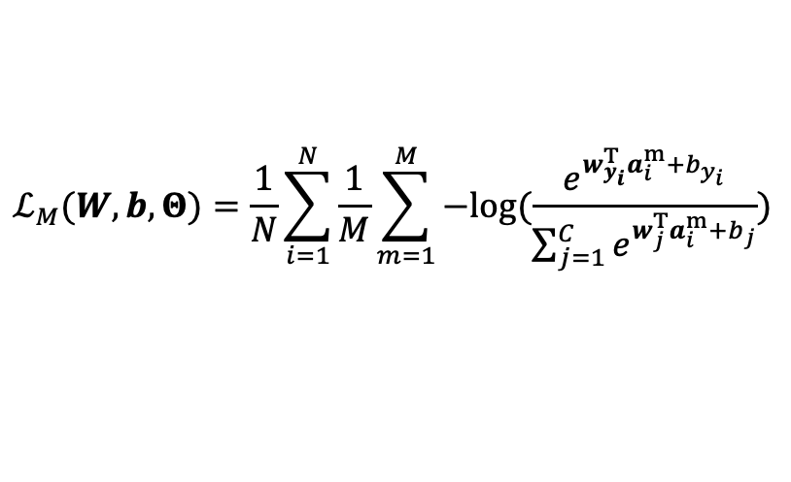
Algorithm
Assume augment $a_{i}=\text{G}\text{(}x_{i}\text{,}Θ)$ for M times forming set ${\text{\{(}a_{i}^{1}\text{,} y_{i}\text{),…,(}a_{i}^{M}\text{,} y_{i}\text{)\}}}_{i=1}^{N}$.Then the network is trained by minimizing the CE loss:
$$ℒ_{M}(W,b,Θ)=\frac{1}{N}\sum_{i=1}^{N}{\frac{1}{M}}\sum_{m=1}^{M}{−log{(\frac{e^{w_{y_{i}}^{T}a_{i}^{m}+b_{y_{i}}}}{\sum_{j=1}^{C}{e^{w_{j}^{T}a_{i}^{m}+b_{j}}}})}}$$
Where $W$=[$w_{1},…,$ $w_{C}$]$∈ℛ^{C×A}$ and $b$=[$b_{1},…,$ $b_{C}$]^{T}$∈ℛ^{C}$. Suppose M $→∞$, $ℒ_{∞}$ is given by:
$$ℒ_{∞}(W,b,Θ|Σ)=\frac{1}{N}\sum_{i=1}^{N}{E_{{\tilde{a}}_{i}}}[−log{(\frac{e^{w_{y_{i}}^{T}{\tilde{a}}_{i}+b_{y_{i}}}}{\sum_{j=1}^{C}{e^{w_{j}^{T}{\tilde{a}}_{i}+b_{j}}}})}]$$

Slide 9

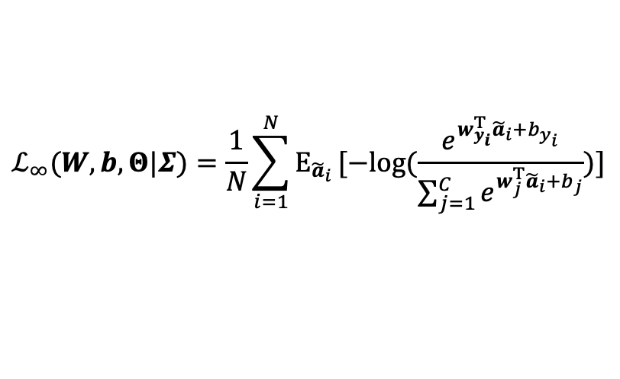
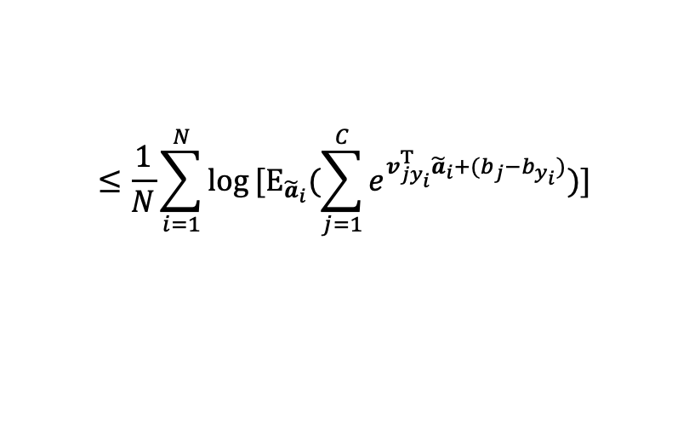
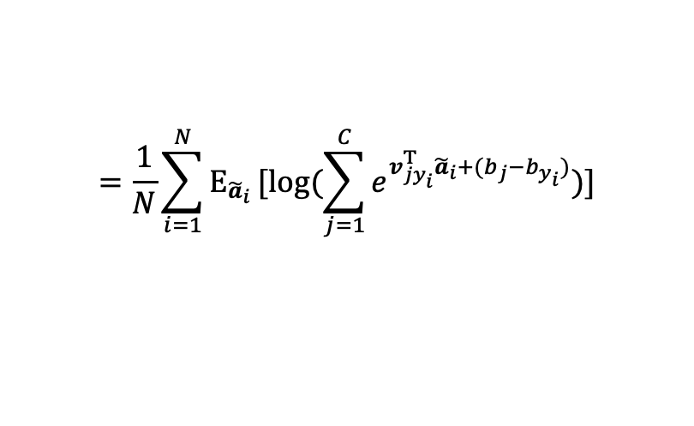
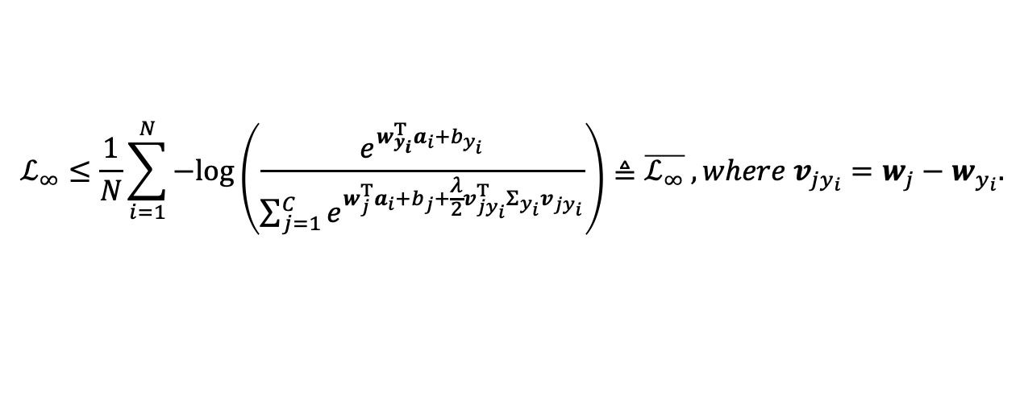
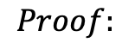

Proposition
$$ℒ_{∞}≤\frac{1}{N}\sum_{i=1}^{N}{−log\left(\frac{e^{w_{y_{i}}^{T}a_{i}+b_{y_{i}}}}{\sum_{j=1}^{C}{e^{w_{j}^{T}a_{i}+b_{j}+\frac{λ}{2}v_{jy_{i}}^{T}Σ_{y_{i}}v_{jy_{i}}}}}\right)}≜\overline{ℒ_{∞}} , where v_{jy_{i}}=w_{j}−w_{y_{i}}.$$
$$ℒ_{∞}(W,b,Θ|Σ)=\frac{1}{N}\sum_{i=1}^{N}{E_{{\tilde{a}}_{i}}}[−log{(\frac{e^{w_{y_{i}}^{T}{\tilde{a}}_{i}+b_{y_{i}}}}{\sum_{j=1}^{C}{e^{w_{j}^{T}{\tilde{a}}_{i}+b_{j}}}})}]$$
$$f(\frac{x_{1}+x_{2}}{2})≥\frac{{f(x}_{1})+{f(x}_{2})}{2}$$
$$Proof:$$
$$f(\frac{x_{1}+…+x_{n}}{n})≥\frac{{f(x}_{1})+…+{f(x}_{n})}{n}$$
$$=\frac{1}{N}\sum_{i=1}^{N}{E_{{\tilde{a}}_{i}}}[\log{(\sum_{j=1}^{C}{e^{v_{jy_{i}}^{T}{\tilde{a}}_{i}+(b_{j}−b_{y_{i}})}})}]$$
$$f\left({p_{1}x}_{1}+…+{p_{n}x}_{n}\right)≥p_{1}f\left(x_{1}\right)+…+p_{n}f(x_{n})$$
$$≤\frac{1}{N}\sum_{i=1}^{N}{log}[E_{{\tilde{a}}_{i}}{(\sum_{j=1}^{C}{e^{v_{jy_{i}}^{T}{\tilde{a}}_{i}+(b_{j}−b_{y_{i}})}})}]$$
$$f\left(E(x)\right)≥E(f\left(x\right))$$

Slide 10
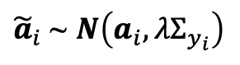
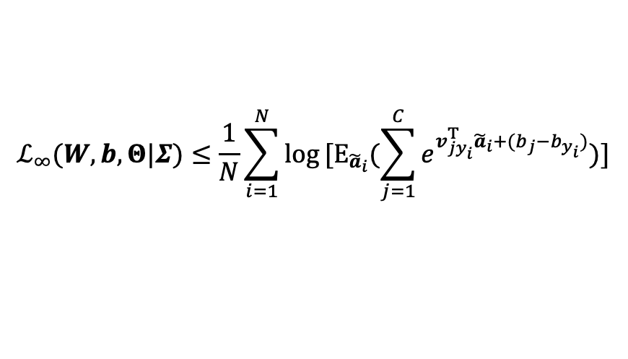


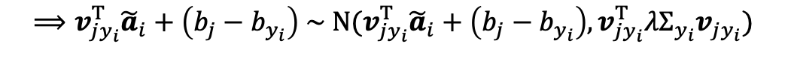
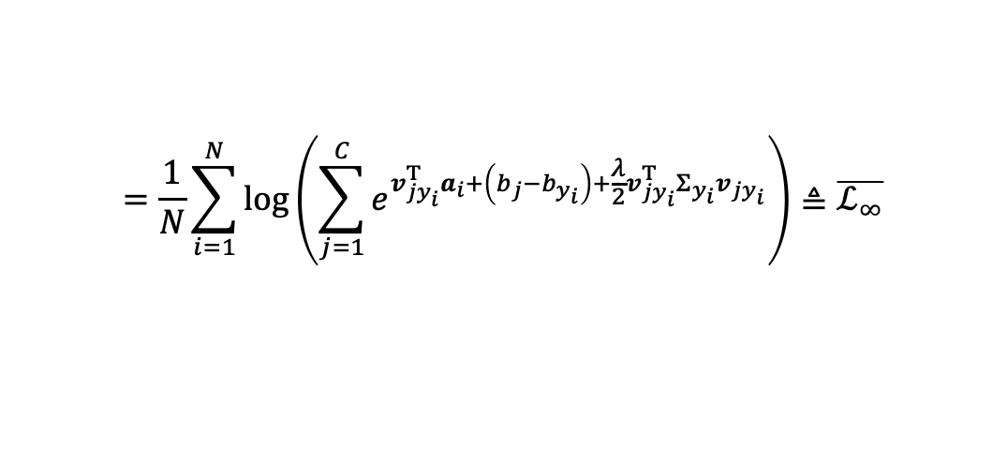
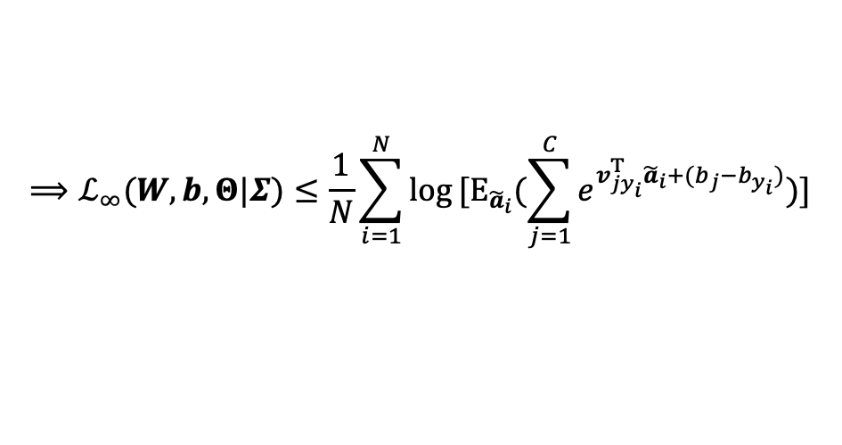
Proposition
$$ℒ_{∞}≤\frac{1}{N}\sum_{i=1}^{N}{−log\left(\frac{e^{w_{y_{i}}^{T}a_{i}+b_{y_{i}}}}{\sum_{j=1}^{C}{e^{w_{j}^{T}a_{i}+b_{j}+\frac{λ}{2}v_{jy_{i}}^{T}Σ_{y_{i}}v_{jy_{i}}}}}\right)}≜\overline{ℒ_{∞}} , where v_{jy_{i}}=w_{j}−w_{y_{i}}.$$
$$ℒ_{∞}(W,b,Θ|Σ)≤\frac{1}{N}\sum_{i=1}^{N}{log}[E_{{\tilde{a}}_{i}}{(\sum_{j=1}^{C}{e^{v_{jy_{i}}^{T}{\tilde{a}}_{i}+(b_{j}−b_{y_{i}})}})}]$$
${\tilde{a}}_{i}$ ~ $Ν\left(a_{i},{λΣ}_{y_{i}}\right)$
$$Proof:$$
$$X\sim N\left(μ,σ^{2}\right),E\left(e^{itX}\right)=e^{itu−\frac{1}{2}σ^{2}t^{2}}$$
$$⟹v_{jy_{i}}^{T}{\tilde{a}}_{i}+\left(b_{j}−b_{y_{i}}\right) \sim N(v_{jy_{i}}^{T}{\tilde{a}}_{i}+\left(b_{j}−b_{y_{i}}\right),v_{jy_{i}}^{T}{λΣ}_{y_{i}}v_{jy_{i}})$$
$$X\sim N\left(μ,σ^{2}\right),E\left(e^{tX}\right)=e^{tu+\frac{1}{2}σ^{2}t^{2}}$$
$$⟹ℒ_{∞}(W,b,Θ|Σ)≤\frac{1}{N}\sum_{i=1}^{N}{log}[E_{{\tilde{a}}_{i}}{(\sum_{j=1}^{C}{e^{v_{jy_{i}}^{T}{\tilde{a}}_{i}+(b_{j}−b_{y_{i}})}})}]$$
$$=\frac{1}{N}\sum_{i=1}^{N}{log}\left(\sum_{j=1}^{C}{e^{v_{jy_{i}}^{T}a_{i}+\left(b_{j}−b_{y_{i}}\right)+\frac{λ}{2}v_{jy_{i}}^{T}Σ_{y_{i}}v_{jy_{i}}}}\right)≜\overline{ℒ_{∞}}$$

Slide 11
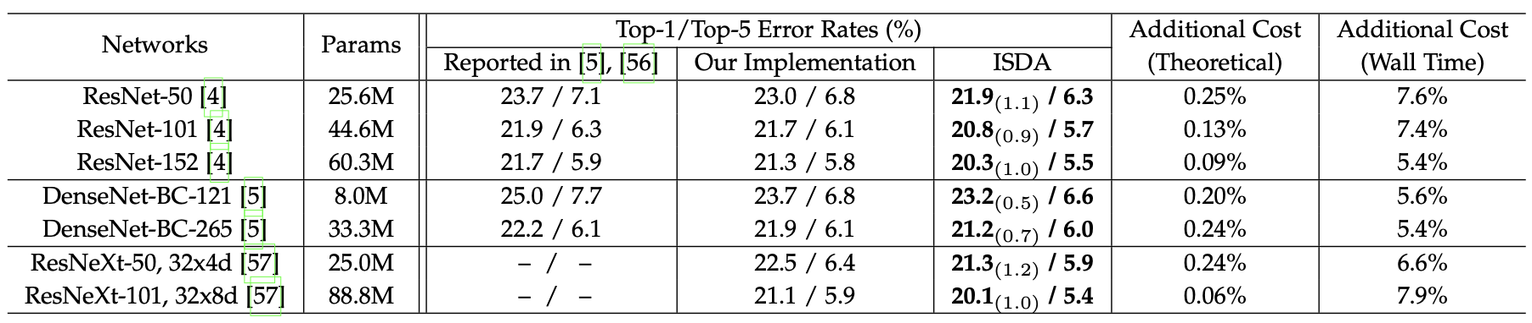
Experiment
ImageNet, 8 Tesla V100 GPU

Slide 12
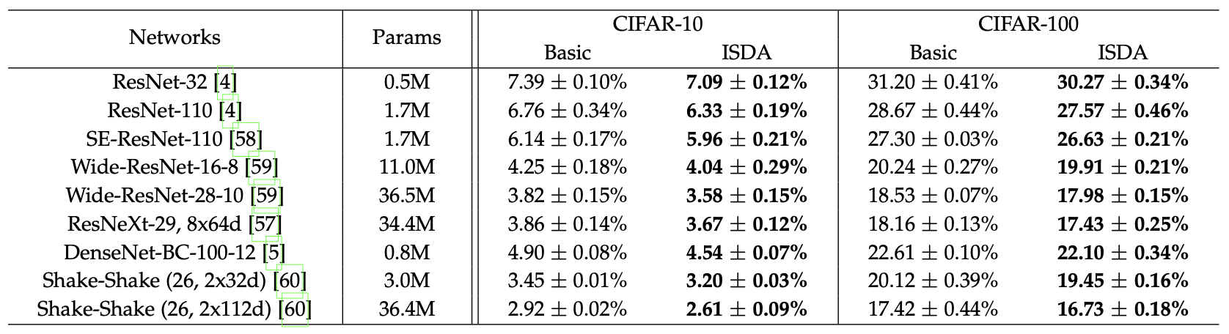
Experiment
CIFAR, 8 Tesla V100 GPU

Slide 13
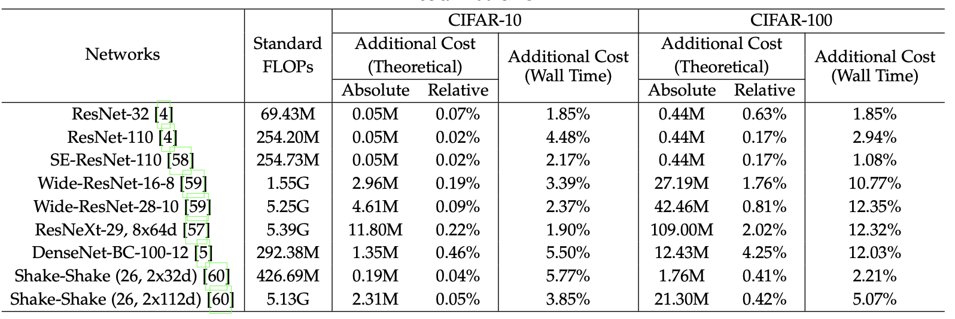
Experiment
COST, 8 Tesla V100 GPU

Slide 14
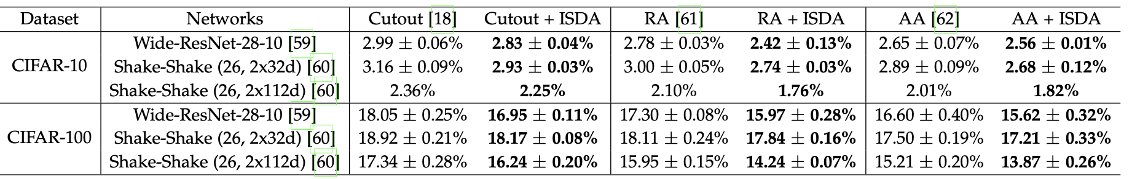
Experiment
SOTA of non-semantic augmentation

Slide 15
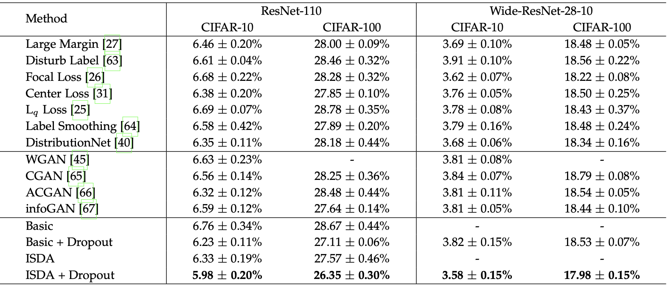
Experiment
SOTA of other approaches

Slide 16
Analytical Results
Visualization of augmented images.

Slide 17
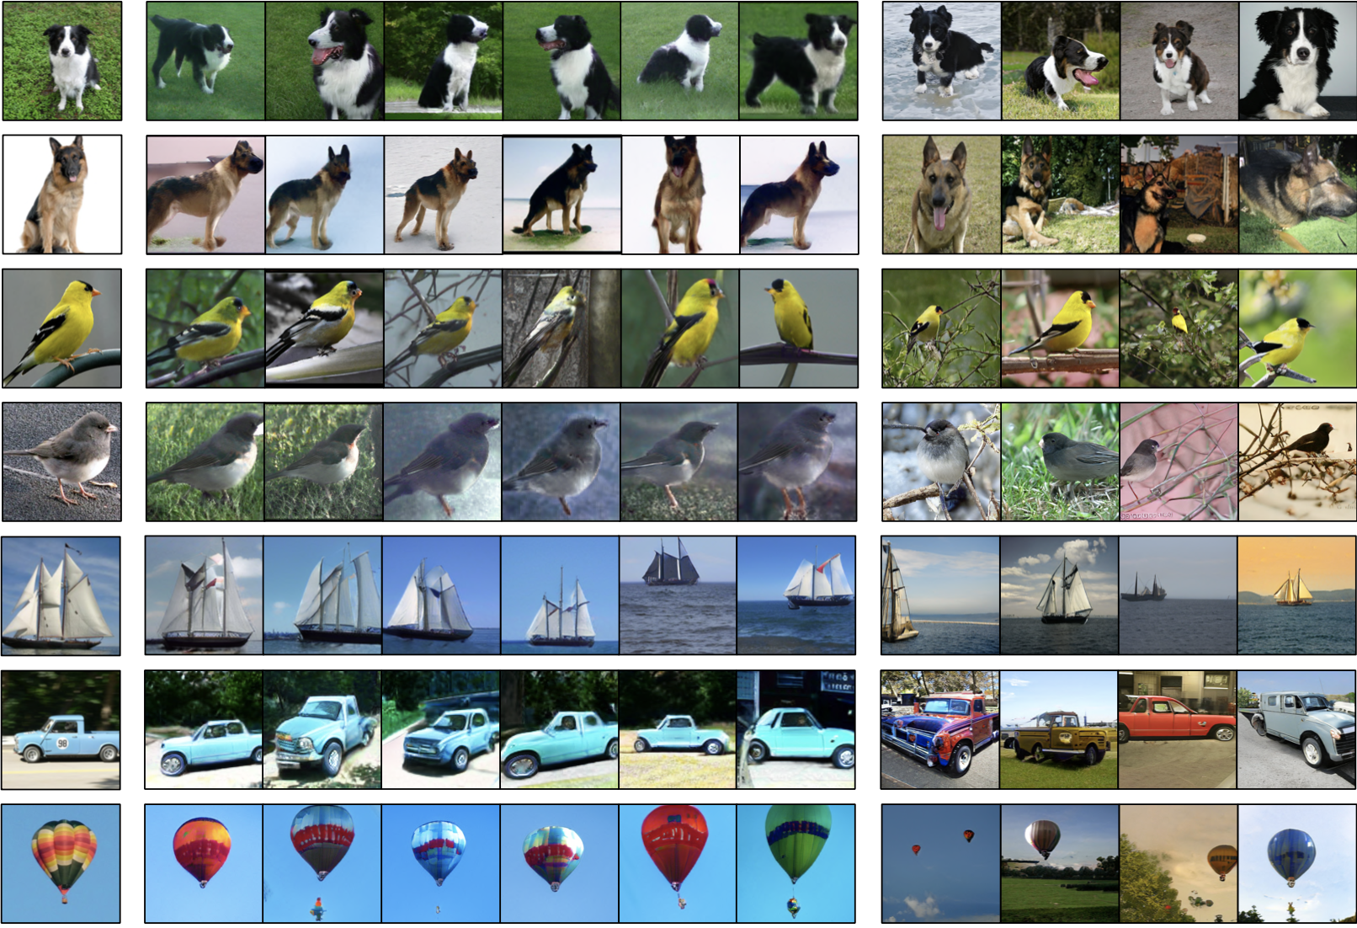
Origin
ISDA
Randomly

Slide 18
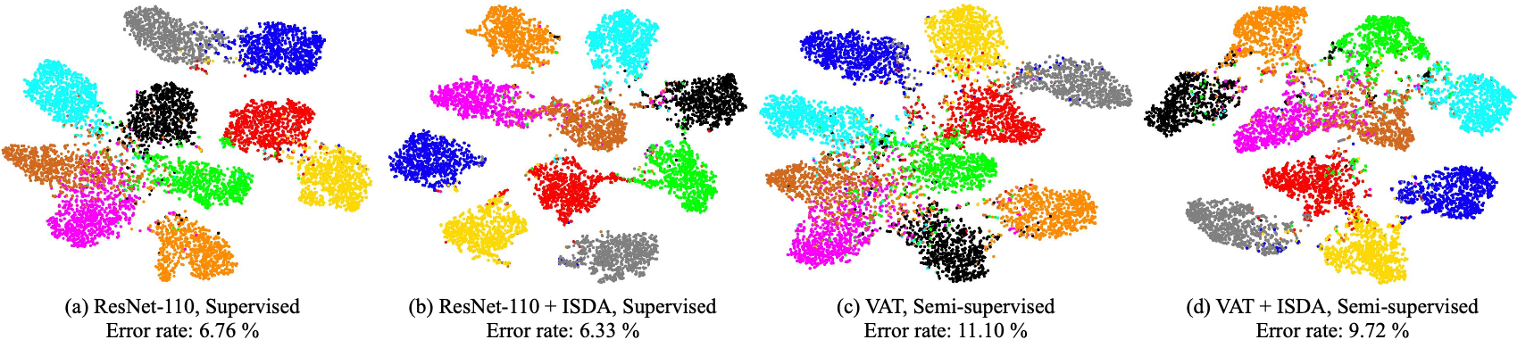
Analytical Results
Visualization of Deep Features. (t-SNE)

Slide 19
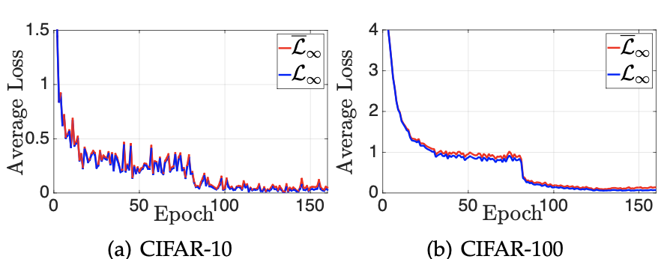
Analytical Results
Tightness of the upper bound $\overline{ℒ_{∞}}$

Slide 20
Conclusion
Efficient & Simple & Robust.
Based on CE.
Code: https://github.com/blackfeather-wang/ISDA-for-Deep-Networks.

Slide 21
Thank you (Q&A)
Notes:
RP Shortcomings：1.relative position has multi result. 2.CNN learn trivial features. 3. not whole picture.

